Slide 1
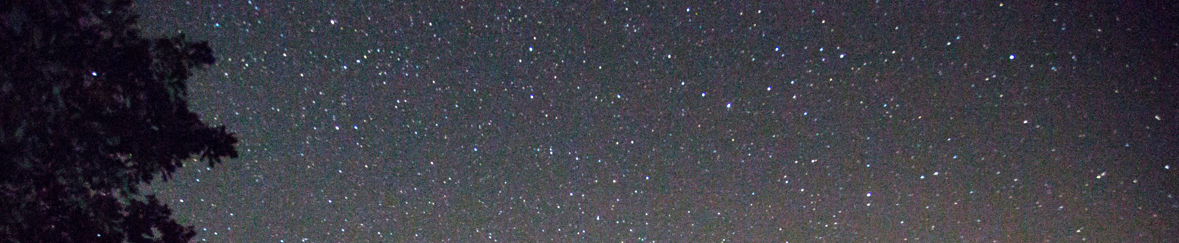


Aries
Tiger
D
NewWord Press
S
ark
treets

Slide 2

D
S
Aries
Tiger
ark
treets

Slide 3
D
Aries
Tiger
S
ark
treets

